Slide 1
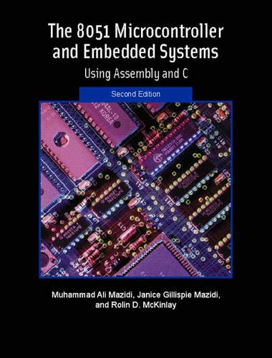
THE 8051
MICROCONTROLLER & Embedded Systems
Muhammad Ali Mazidi, Janice Mazidi
& Rolin McKinlay

Slide 2
ARITHMETIC, LOGIC
INSTRUCTIONS, AND PROGRAMS
Chapter 6

Slide 3
Objectives
Upon completion of this chapter, you will be able to:
>> Define the range of numbers possible in 8051 unsigned data
>> Code addition and subtraction instructions for unsigned data
>> Perform addition of BCD data
>> Code 8051 unsigned data multiplication and division instructions
>> Code 8051 Assembly language logic instructions AND, OR, and EX-OR
>> Use 8051 logic instructions for bit manipulation
>> Use compare and jump instructions for program control
>> Code 8051 rotate instruction and data serialization
>> Explain the BCD (binary coded decimal) system of data representation
>> Contrast and compare packed and unpacked BCD data
>> Code 8051 programs for ASCII and BCD data conversion
>> Code 8051 programs to create and test the checksum byte

Slide 4
Objectives
Describing all 8051 arithmetic and logic instructions,
Section 6.1, instructions and programs related to addition, subtraction, multiplication, and division of unsigned numbers,
Section 6.2, Signed numbers,
Section 6.3, the logic instructions AND, OR, and XOR, as well as the COMPARE instruction,
Section 6.4, the ROTATE instruction and data serialization,
Section 6.5, some real-world applications such as BCD and ASCII conversion and checksum byte testing

Slide 5
Example 6-1
Show how the flag register is affected by the following instructions.
MOV A,#0F5H ;A=F5 hex
ADD A,#0BH ;A=F5+0B=00
Solution:
F5H 1111 0101
+ 0BH + 0000 1011
100H 0000 0000
After the addition, register A (destination) contains 00 and the flags are as follows:
CY = 1 since there is a carry out from D7.
P = 0 because the number of 1s is zero (an even number).
AC = 1 since there is a carry from D3 to D4.

Slide 6
Example 6-2
Assume that RAM locations 40 - 44 have the following values. Write a program to find the sum of the values. At the end of the program, register A should contain the low byte and R7 the high byte. All values are in hex.
40=(7D) 41=(EB) 42=(C5) 43=(5B) 44=(30)
Solution:
MOV R0,#40H ;load pointer
MOV R2,#5 ;load counter
CLR A ;A=0
MOV R7,A ;clear R7
AGAIN: ADD A,@R0 ;add the byte pointer to A by R0
JNC NEXT ;if CY=0 don’t accumulate carry
INC R7 ;keep track of carries
NEXT: INC R0 ;increment pointer
DJNZ R2,AGAIN ;repeat until R2 is zero

Slide 7
Example 6-3
Write a program to add two 16-bit numbers. The numbers are 3CE7H and 3B8DH. Place the sum in R7 and R6; R6 should have the lower byte.
Solution:
CLR C ;make CY=0
MOV A,#0E7H ;load the low byte now A=E7H
ADD A,#8DH ;add the low byte now A=74H and CY=1
MOV R6,A ;save the low byte of the sum in R6
MOV A,#3CH ;load the high byte
ADDC A,#3BH ;add with the carry
;3B + 3C + 1 = 78(all in hex)
MOV R7,A ;save the high byte of the sum

Slide 8
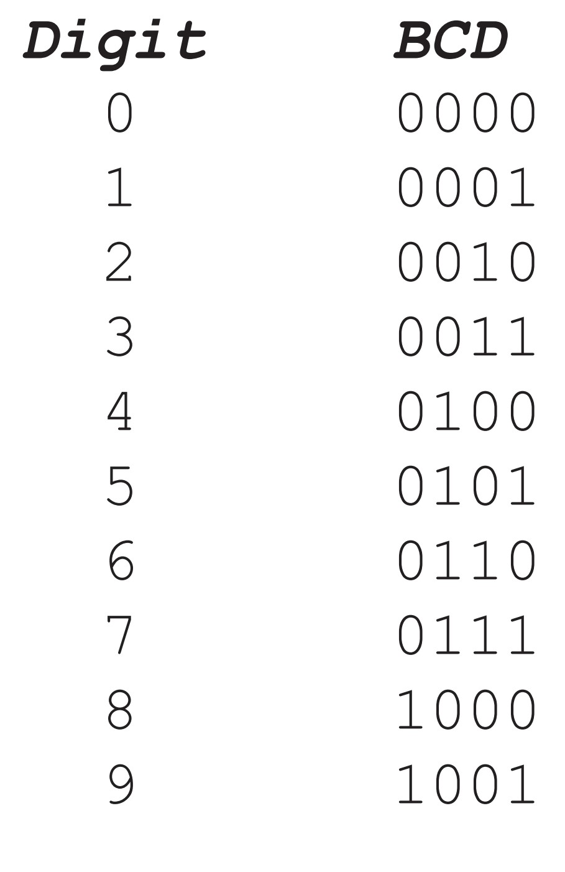
Figure 6-1. BCD Code

Slide 9
Example 6-4
Assume that 5 BCD data items are stored in RAM locations starting at 40H, as shown below. Write a program to find the sum of all the numbers. The result must be in BCD.
40=(71) 41=(11) 42=(65) 43=(59) 44=(37)
Solution:
MOV R0,#40H ;load pointer
MOV R2,#5 ;load counter
CLR A ;A=0
MOV R7,A ;clear R7
AGAIN: ADD A,@R0 ;add the byte pointer to A by R0
DA A ;adjust for BCD
JNC NEXT ;if CY=0 don’t accumulate carry
INC R7 ;keep track of carries
NEXT: INC R0 ;increment pointer
DJNZ R2,AGAIN ;repeat until R2 is zero

Slide 10
Example 6-5
Show the steps involved in the following.
CLR C ;make CY=0
MOV A,#3FH ;load 3FH into A (A = 3FH)
MOV R3,#23H ;load 23H into R3 (R3 = 23H)
SUBB A,R3 ;subtract A - R3, place result in A
Solution:
A = 3F 0011 1111 0011 1111
R3 = 23 0010 0011 + 1101 1101 (2’s complement)
1C 1 0001 1100
0 CF=0 (step 3)
The flags would be set as follows: CY = 0, AC = 0, and the programmer must look at the carry flag to determine if the result is positive or negative.

Slide 11
Example 6-6
Analyze the following program:
CLR C
MOV A,#4CH ;load A with value 4CH (A=4CH)
SUBB A,#6EH ;subtract 6E from A
JNC NEXT ;if CY=0 jump to NEXT target
CPL A ;if CY=1 then take 1’s complement
INC A ;and increment to get 2’s complement
NEXT:MOV R1,A ;save A in R1
Solution:
Following are the steps for “SUBB A, #6EH”:
4C 0100 1100 0100 1100
- 6E 0110 1110 2’s comp = 1001 0010
-22 0 1101 1110
CY = 1, the result is negative, in 2’s complement.

Slide 12
Example 6-7
Analyze the following program:
CLR C ;CY = 0
MOV A,#62H ;A = 62H
SUBB A,#96H ;62H - 96H = CCH with CY = 1
MOV R7,A ;save the result
MOV A,#27H ;A=27H
SUBB A,#12H ;27H - 12H - 1 = 14H
MOV R6,A ;save the result
Solution:
After the SUBB, A = 62H - 96H = CCH and the carry flag is set high indicating there is a borrow. Since CY = 1, when SUBB is executed the second time A = 27H - 12H - 1 = 14H. Therefore, we have 2762H - 1296H = 14CCH.

Slide 13
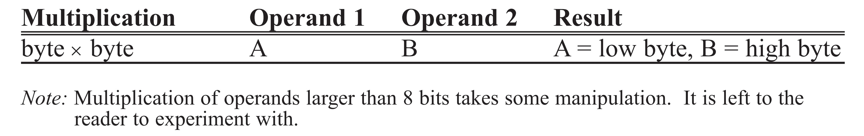
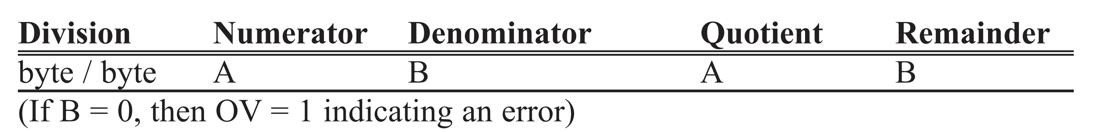
Table 6-1: Unsigned Multiplication Summary (MUL AB)
Table 6-2: Unsigned Division Summary (DIV AB)

Slide 14
Example 6-8
Write a program (a) to make P1 an input port, (b) to get a byte of hex data in the range of 00 - FFH from P1 and convert it to decimal. Save the digits in R7, R6, and R5, where the least significant digit is in R7.
Solution:
MOV A,#0FFH
MOV P1,A ;make P1 an input port
MOV A,P1 ;read data from P1
MOV B,#10 ;B=0A hex (10 dec)
DIV AB ;divide by 10
MOV R7,B ;save lower digit
MOV B,#10 ;
DIV AB ;divide by 10 once more
MOV R6,B ;save the next digit
MOV R5,A ;save the last digit
The input value from P1 is in the hex range of 00 - FFH or in binary 00000000 to 11111111. This program will not work if the input data is in BCD. In other words, this program converts from binary to decimal. To convert a single decimal digit to ASCII format, we OR it with 30H as shown in Sections 6.4 and 6.5.

Slide 15
Example 6-9
Analyze the program in Example 6-8, assuming that P1 has a value of FDH for data.
Solution:
To convert a binary (hex) value to decimal, we divide it by 10 repeatedly until the quotient is less than 10. After each division the remainder is saved. In the case of an 8-bit binary such as FDH we have 253 decimal as shown below (all in hex).
Quotient Remainder
FD/0A= 19 3 (low digit)
19/0A= 2 5 (middle digit)
2 (high digit)
Therefore, we have FDH = 253. In order to display this data it must be converted to ASCII, which is described in a later section in this chapter.

Slide 16
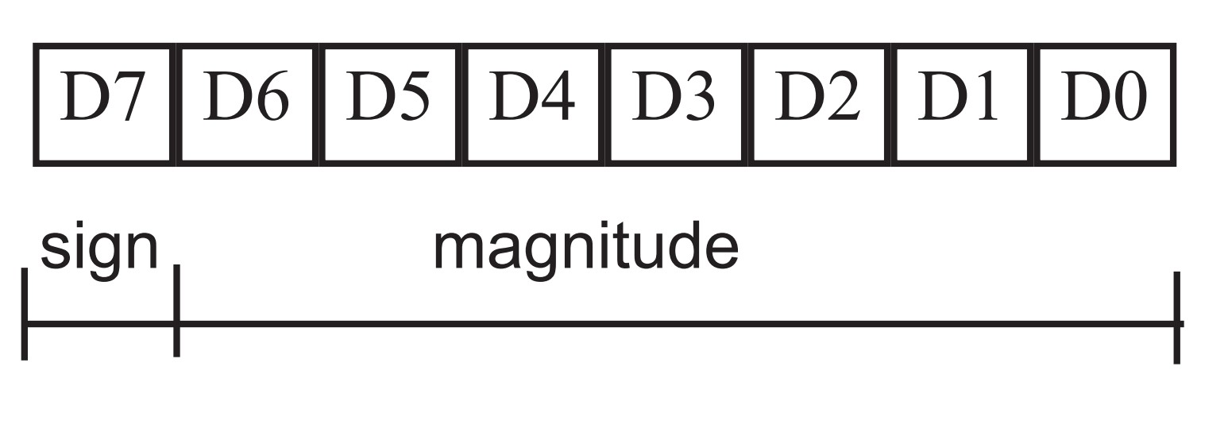
Figure 6-2. 8-Bit Signed Operand

Slide 17
Example 6-10
Show how the 8051 would represent -5.
Solution:
Observe the following steps.
1. 0000 0101 5 in 8-bit binary
2. 1111 1010 invert each bit
3. 1111 1011 add 1 (which becomes FB in hex)
Therefore -5 = FBH, the signed number representation in 2’s complement for -5.

Slide 18
Example 6-11
Show how the 8051 would represent -34H.
Solution:
Observe the following steps.
1. 0011 0100 34H given in binary
2. 1100 1011 invert each bit
3. 1100 1100 add 1 (which is CC in hex)
Therefore -34 = CCH, the signed number representation in 2’s complement for -34H.

Slide 19
Example 6-12
Show how the 8051 would represent -128.
Solution:
Observe the following steps.
1. 1000 0000 128 in 8-bit binary
2. 0111 1111 invert each bit
3. 1000 0000 add 1 (which becomes 80 in hex)
Therefore -128 = 80H, the signed number representation in 2’s complement for -128.

Slide 20
Example 6-13
Examine the following code and analyze the result.
MOV A,#+96 ;A = 0110 0000 (A = 60H)
MOV R1,#+70 ;R1 = 0100 0110 (R1 = 46H)
ADD A,R1 ;A = 1010 0110
;A = A6H = -90 decimal, INVALID!
Solution:
+96 0110 0000
+ +70 0100 0110
+ 166 1010 0110 and OV=1
According to the CPU, the result is -90, which is wrong. The CPU sets OV = 1 to indicate the overflow.

Slide 21
Example 6-14
Observe the following, noting the role of the OV flag.
MOV A,#-128 ;A = 1000 0000 (A = 80H)
MOV R4,#-2 ;R4 = 1111 1110(R4 = FEH)
ADD A,R4 ;A = 0111 1110 (A=7EH=+126, invalid)
Solution:
-128 1000 0000
+ -2 1111 1110
-130 0111 1110 and OV=1
According to the CPU, the result is +126, which is wrong (OV = 1).

Slide 22
Example 6-15
Observe the following, noting the OV flag.
MOV A,#-2 ;A=1111 1110 (A=FEH)
MOV R1,#-5 ;R1=1111 1011(R1=FBH)
ADD A,R1 ;A=1111 1001 (A=F9H=-7,correct,OV=0)
Solution:
-2 1111 1110
+ -5 1111 1011
-7 1111 1001 and OV = 0
According to the CPU, the result is -7, which is correct (OV = 0).

Slide 23
Example 6-16
Examine the following, noting the role of OV.
MOV A,#+7 ;A=0000 0111 (A=07H)
MOV R1,#+18 ;R1=0001 0010(R1=12H)
ADD A,R1 ;A=0001 1001 (A=19H=+25, correct,OV=0)
Solution:
7 0000 0111
+ 18 0001 0010
25 0001 1001 and OV = 0
According to the CPU, this is +25, which is correct (OV = 0)

Slide 24
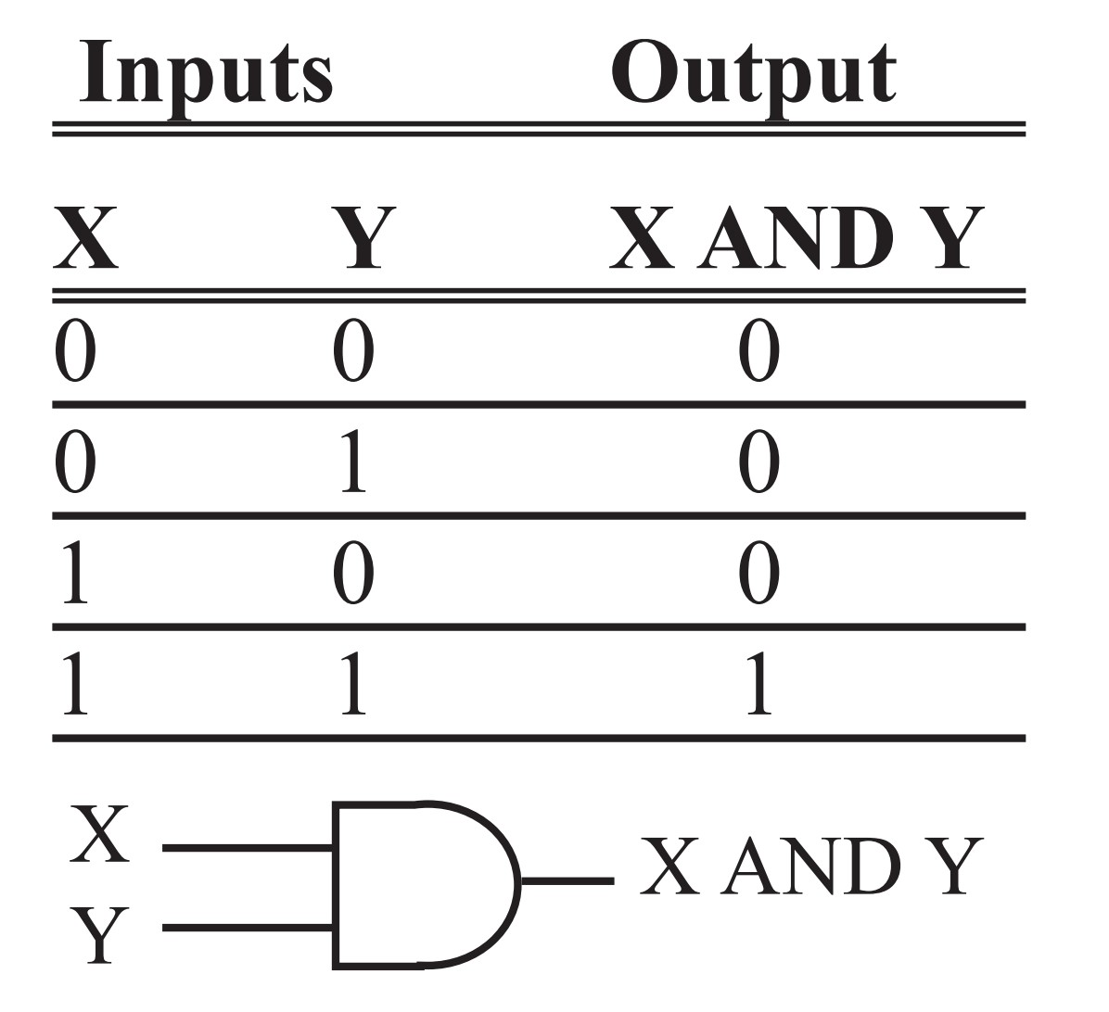
Logical AND Function

Slide 25
Example 6-17
Show the results of the following.
MOV A,#35H ;A = 35H
ANL A,#0FH ;A = A AND 0FH (now A = 05)
Solution:
35H 0011 0101
0FH 0000 1111
05H 0000 0101 35H AND 0FH = 05H

Slide 26
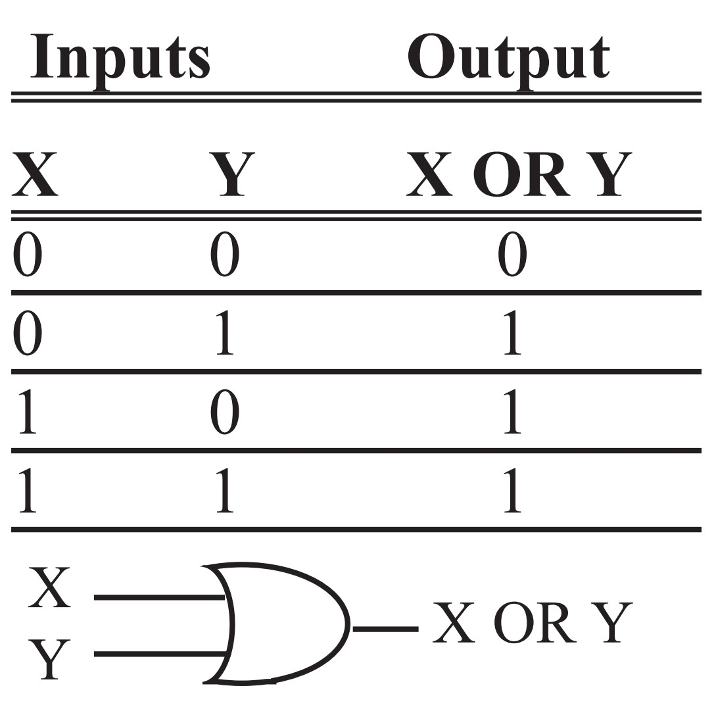
Logical OR Function

Slide 27
Example 6-18
Show the results of the following.
MOV A,#04 ;A = 04
ORL A,#30H ;A = A OR 30H (now A = 34H)
Solution:
04H 0000 0100
30H 0011 0000
34H 0011 0100 04H OR 30H = 34H

Slide 28
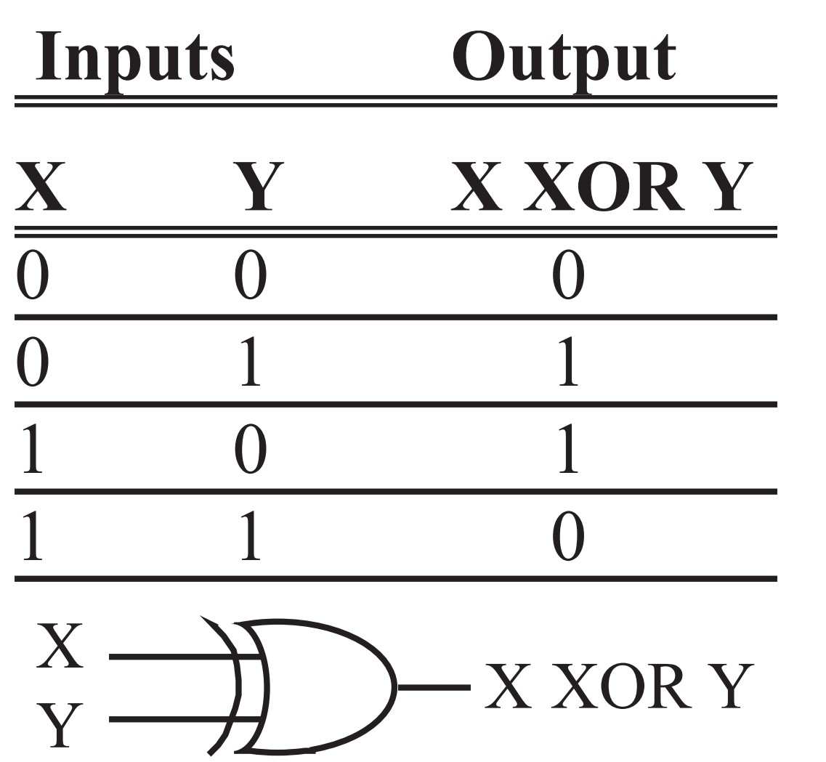
Logical XOR Function

Slide 29
Example 6-19
Show the results of the following.
MOV A,#54H
XRL A,#78H
Solution:
54H 0101 0100
78H 0111 1000
2CH 0010 1100 54H XOR 78H = 2CH

Slide 30
Example 6-20
The XRL instruction can be used to clear the contents of a register by XORing it with itself. Show how “XRL A, A” clears A, assuming that A = 45H.
Solution:
45H 0100 0101
45H 0100 0101
00 0000 0000 XOR a number with itself = 0

Slide 31
Example 6-21
Read and test P1 to see whether it has the value 45H. If it does, send 99H to P2; otherwise, it stays cleared.
Solution:
MOV P2,#00 ;clear P2
MOV P1,#0FFH ;make P1 an input port
MOV R3,#45H ;R3=45H
MOV A,P1 ;read P1
XRL A,R3
JNZ EXIT ;jump if A has value other than 0
MOV P2,#99H
EXIT:...

Slide 32
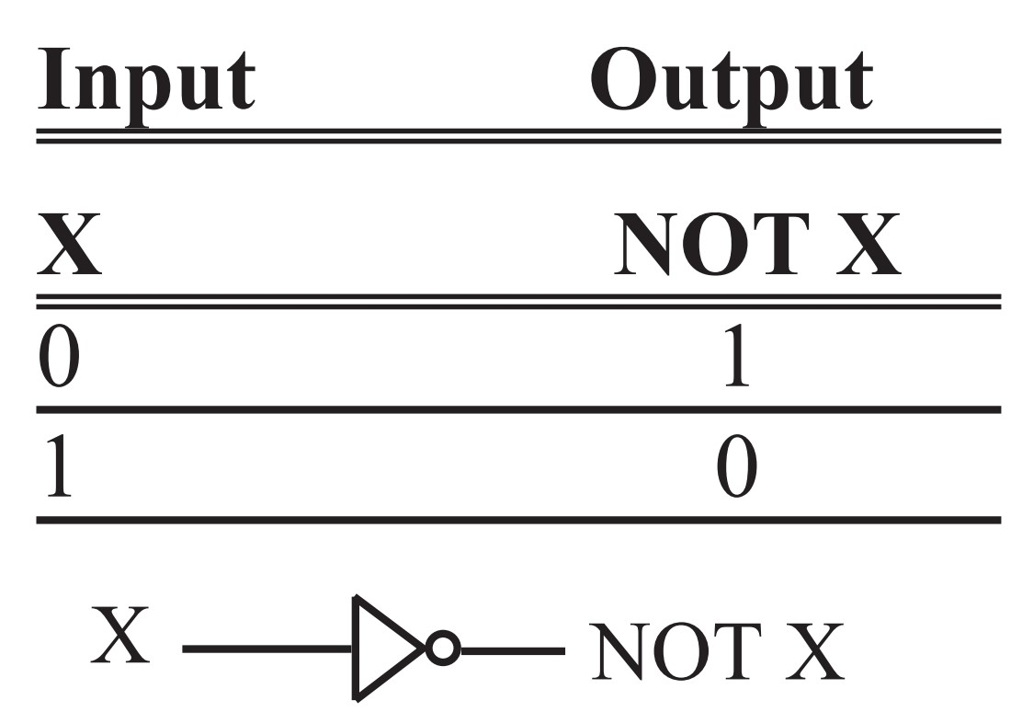
Logical Inverter

Slide 33
Example 6-22
Find the 2’s complement of the value 85H.
Solution:
MOV A,#85H 85H = 1000 0101
CPL A ;1’s comp. 1’S = 0111 1010
ADD A,#1 ;2’s comp. + 1
0111 1011 = 7BH

Slide 34
Example 6-23
Examine the following code, then answer the following questions.
(a) Will it jump to NEXT?
(b) What is in A after the CJNE instruction is executed?
MOV A,#55H
CJNE A,#99H,NEXT
...
NEXT: ...
Solution:
(a) Yes, it jumps because 55H and 99H are not equal.
(b) A = 55H, its original value before the comparison.

Slide 35
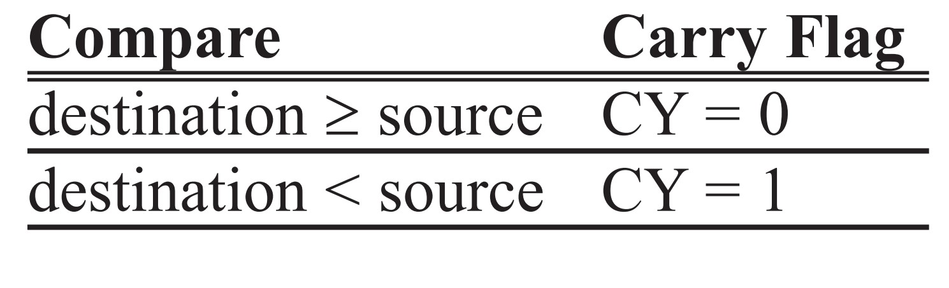
Table 6-3: Carry Flag Setting For CJNE Instruction

Slide 36
Example 6-24
Write code to determine if register A contains the value 99H. If so, make R1 = FFH; otherwise, make R1 = 0.
Solution:
MOV R1,#0 ;clear R1
CJNE A,#99H,NEXT ;if A not equal to 99, then jump
MOV R1,#0FFH ;they are equal, make R1 = FFH
NEXT:... ;not equal so R1 = 0
OVER:...

Slide 37
Example 6-25
Assume that P1 is an input port connected to a temperature sensor. Write a program to read the temperature and test it for the value 75. According to the test results, place the temperature value into the registers indicated by the following.
If T = 75 then A = 75
If T < 75 then R1 = T
If T > 75 then R2 = T
Solution:
MOV P1,#0FFH ;make P1 an input port
MOV A,P1 ;read P1 port, temperature
CJNE A,#75,OVER ;jump if A not equal to 75
SJMP EXIT ;A=75, exit
OVER: JNC NEXT ;if CY=0 then A>75
MOV R1,A ;CY=1, A<75, save in R1
SJMP EXIT ;and exit
NEXT: MOV R2,A ;A>75, save it in R2
EXIT: ...

Slide 38
Example 6-26
Write a program to monitor P1 continuously for the value 63H. It should stop monitoring only if P1 = 63H.
Solution:
MOV P1,#0FFH ;make P1 an input port
HERE: MOV A,P1 ;get P1
CJNE A,#63,HERE ;keep monitoring unless P1=63H

Slide 39
Example 6-27
Assume internal RAM memory locations 40H - 44H contain the daily temperature for five days, as shown below. Search to see if any of the values equals 65. If value 65 does exist in the table, give its location to R4; otherwise, make R4 = 0.
40H=(76) 41H=(79) 42H=(69) 43H=(65) 44H=(62)
Solution:
MOV R4,#0 ;R4=0
MOV R0,#40H ;load pointer
MOV R2,#05 ;load counter
BACK: MOV A,@R0 ;get the byte from RAM
CJNE A,#65,NEXT ;compare RAM data with 65
MOV A,R0 ;if 65, save address
MOV R4,A
SJMP EXIT ;and exit
NEXT: INC R0 ;otherwise increment pointer
DJNZ R2,BACK ;keep checking until count=0
EXIT: SJMP EXIT

Slide 40
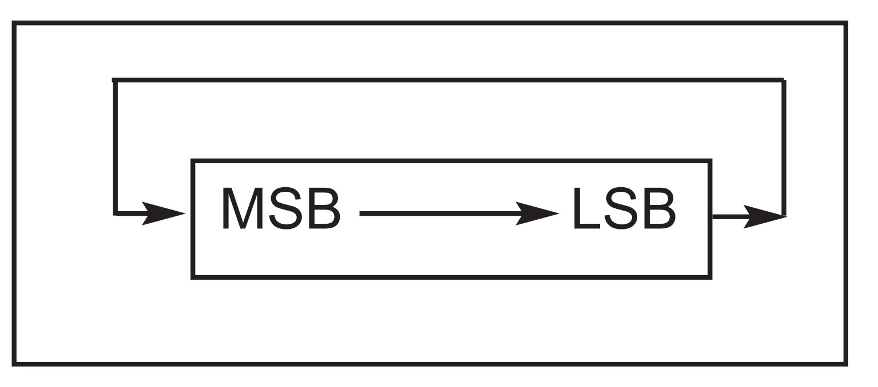
RR A ;rotate right A

Slide 41
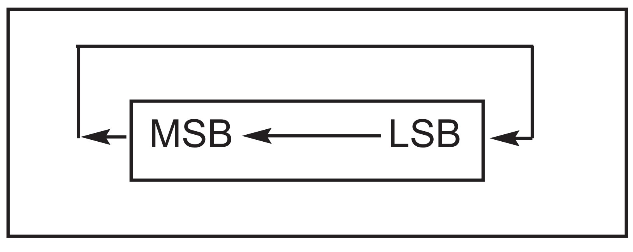
RL A ;rotate left A

Slide 42
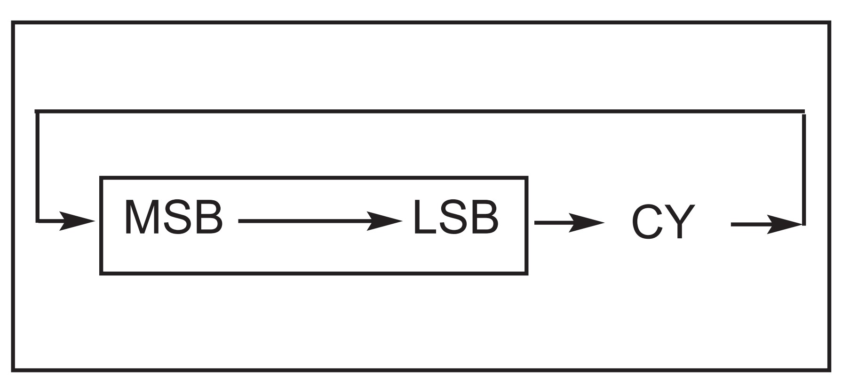
RRC A ;rotate right through carry

Slide 43
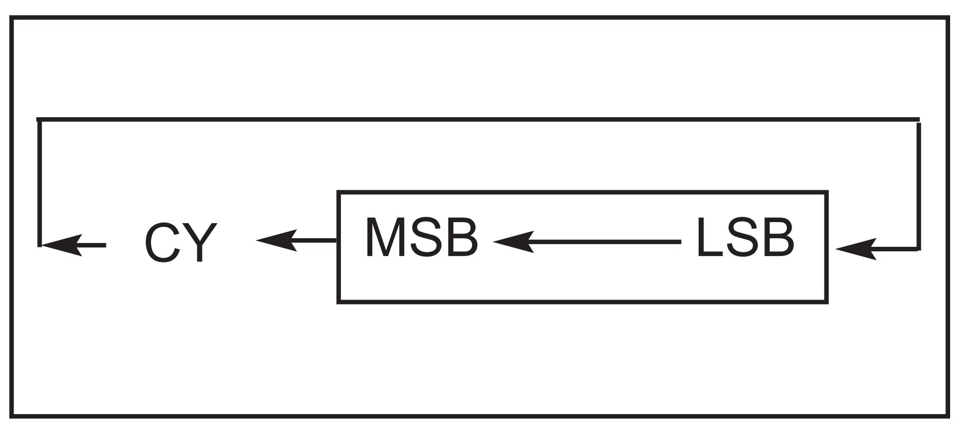
RLC A ;rotate left through carry

Slide 44
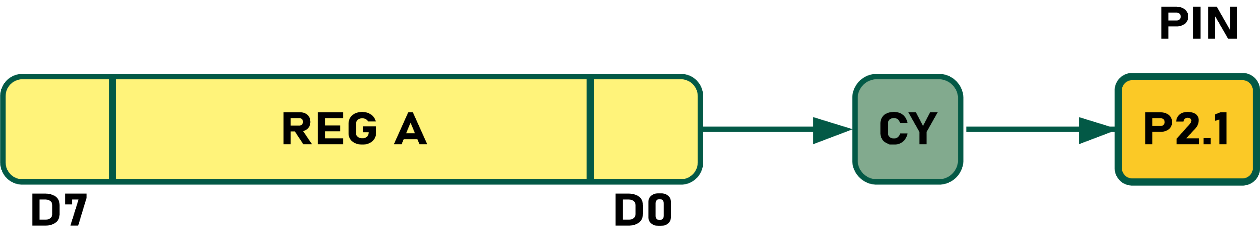
Example 6-28
Write a program to transfer value 41H serially (one bit at a time) via pin P2.1. Put two highs at the start and end of the data. Send the byte LSB first.
Solution:
MOV A,#41H
SETB P2.1 ;high
SETB P2.1 ;high
MOV R5, #8
HERE:RRC A
MOV P2.1,C ;send the carry bit to P2.1
DJNZ R5, HERE
SETB P2.1 ;high
SETB P2.1 ;high

Slide 45
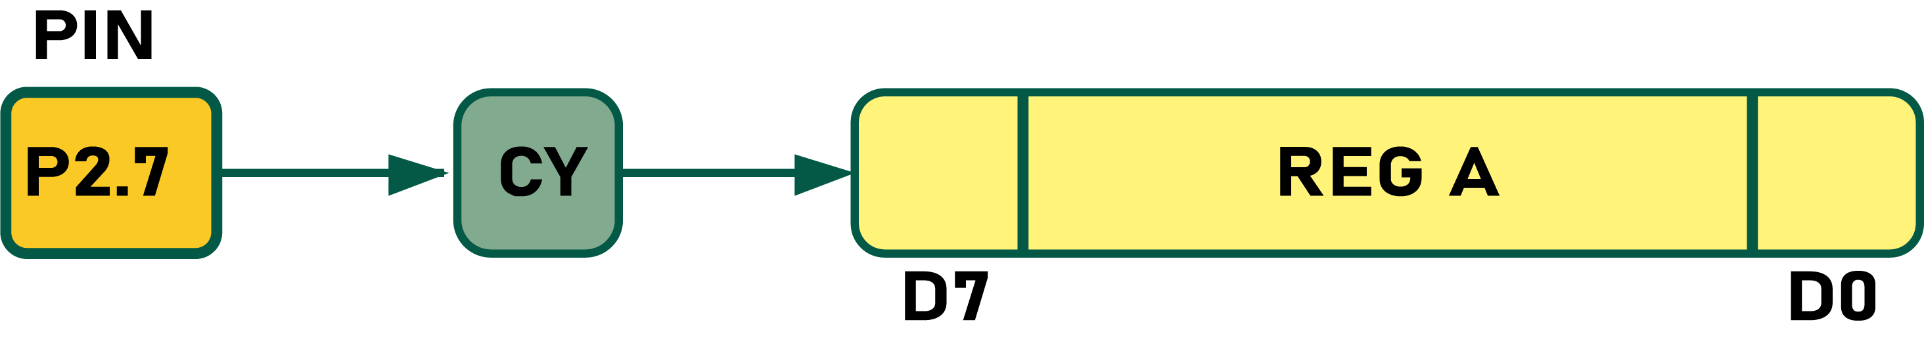
Example 6-29
Write a program to bring in a byte of data serially one bit at a time via pin P2.7 and save it in register R2. The byte comes in with the LSB first.
Solution:
MOV R5, #8
HERE: MOV C,P2.7 ; bring in bit
RRC A
DJNZ R5, HERE
MOV R2,A ;save it

Slide 46
Example 6-30
Write a program to save the status of bits P1.2 and P1.3 on RAM bit locations 6 and 7, respectively.
Solution:
MOV C,P1.2 ;save status of P1.2 on CY
MOV 06,C ;save carry in RAM bit location 06
MOV C,P1.3 ;save status of P1.3 on CY
MOV 07,C ;save carry in RAM bit location 07

Slide 47
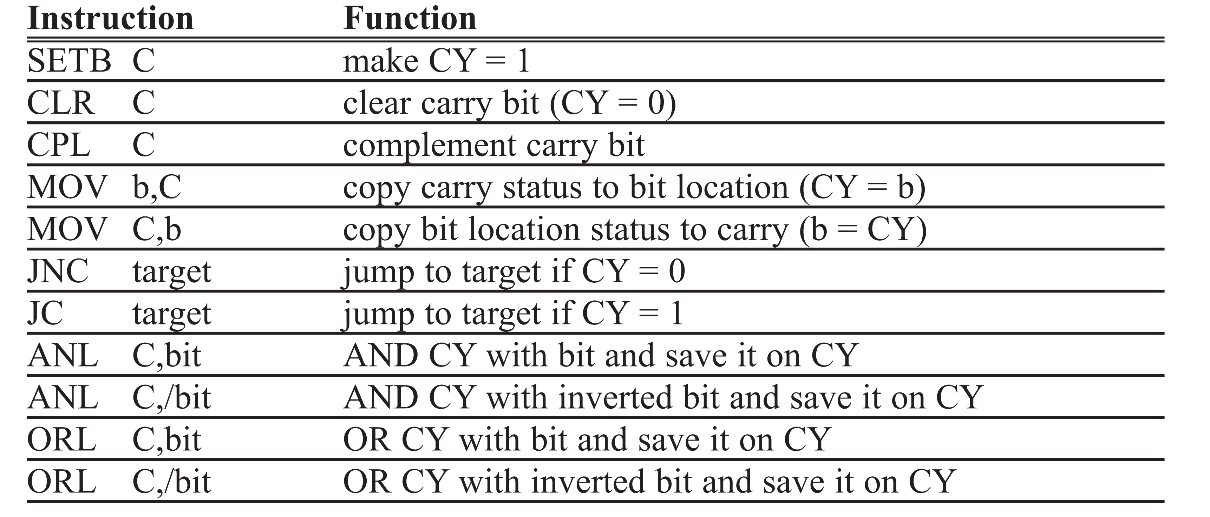
Table 6-4: Carry Bit-Related Instructions

Slide 48
Example 6-31
Assume that bit P2.2 is used to control an outdoor light and bit P2.5 a light inside a building. Show how to turn on the outside light and turn off the inside one.
Solution:
SETB C ;CY = 1
ORL C,P2.2 ;CY = P2.2 ORed with CY
MOV P2.2,C ;turn it "on" if not already "on"
CLR C ;CY = 0
ANL C,P2.5 ;CY = P2.5 ANDed with CY
MOV P2.5,C ;turn it off if not already off

Slide 49
Example 6-32
Write a program that finds the number of 1s in a given byte.
Solution:
MOV R1,#0 ;R1 keeps the number of 1s
MOV R7,#8 ;counter = 08 rotate 8 times
MOV A,#97H ;find the number of 1s in 97H
AGAIN: RLC A ;rotate it through the CY once
JNC NEXT ;check for CY
INC R1 ;if CY=1 then add one to count
NEXT: DJNZ R7,AGAIN ;go through this 8 times

Slide 50
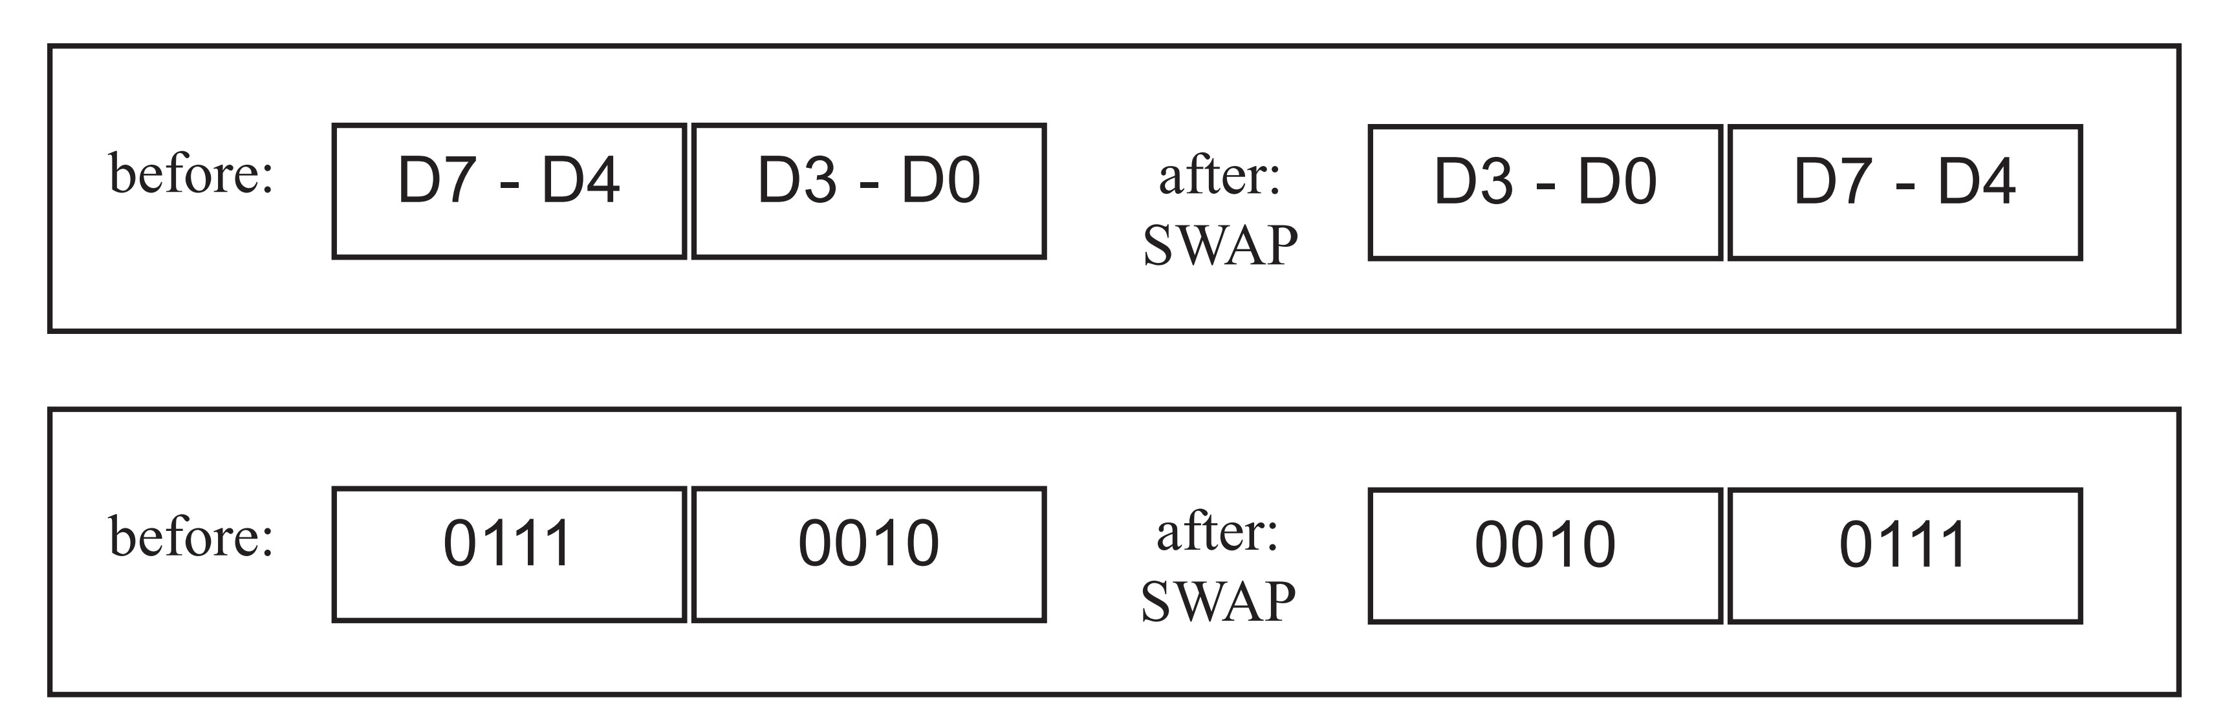
SWAP A

Slide 51
Example 6-33
(a) Find the contents of register A in the following code.
(b) In the absence of a SWAP instruction, how would you exchange the nibbles?
Write a simple program to show the process.
Solution:
(a) MOV A,#72H ;A = 72H
SWAP A ;A = 27H
(b)
MOV A,#72H ;A=0111 0010
RL A ;A=1110 0100
RL A ;A=1100 1001
RL A ;A=1001 0011
RL A ;A=0010 0111

Slide 52
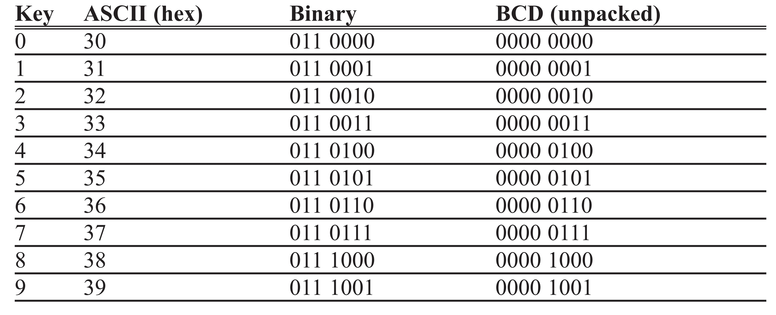
Table 6-5: ASCII Code for Digits 0 - 9

Slide 53
Example 6-34
Assume that register A has packed BCD. Write a program to convert packed BCD to two ASCII numbers and place them in R2 and R6.
Solution:
MOV A,#29H ;A=29H, packed BCD
MOV R2,A ;keep a copy of BCD data in R2
ANL A,#0FH ;mask the upper nibble(A=09)
ORL A,#30H ;make it an ASCII, A=39H ('9')
MOV R6,A ;save it (R6=39H ASCII char)
MOV A,R2 ;A=29H, get the original data
ANL A,#0F0H ;mask the lower nibble(A=20)
RR A ;rotate right
RR A ;rotate right
RR A ;rotate right
RR A ;rotate right,(A=02)
ORL A,#30H ;A=32H, ASCII char '2'
MOV R2,A ;save ASCII char in R2
Of course, in the above code we can replace all the RR instructions with a single “SWAP A” instruction.

Slide 54
Example 6-35
Assume that the lower three bits of P1 are connected to three switches. Write a program to send the following ASCII characters to P2 based on the status of the switches.
000 ‘0’
001 ‘1’
010 ‘2’
011 ‘3’
100 ‘4’
101 ‘5’
110 ‘6’
111 ‘7’
Solution:
MOV DPTR,#MYTABLE
MOV A,P1 ;get SW status
ANL A,#07H ;mask all but lower 3 bits
MOVC A,@A+DPTR ;get the data from look-up table
MOV P2,A ;display value
SJMP $ ;stay here
;---------------------
ORG 400H
MYTABLE DB '0','1','2','3','4','5','6','7'
END
You can easily modify this program for the hex values of 0 - F, which are supplied by 4x4 keyboards. See Chapter 12 for a keyboard example.

Slide 55
Example 6-36
Assume that we have 4 bytes of hexadecimal data: 25H, 62H, 3FH, and 52H.
(a) Find the checksum byte, (b) perform the checksum operation to ensure data integrity, and (c) if the second byte 62H has been changed to 22H, show how checksum detects the error.
Solution:
(a) Find the checksum byte.
25H
+ 62H
+ 3FH
+ 52H
118H
(Dropping the carry of 1, we have 18H. Its 2’s complement is E8H.
Therefore the checksum byte is E8H.)

Slide 56
Example 6-36
Assume that we have 4 bytes of hexadecimal data: 25H, 62H, 3FH, and 52H.
(a) Find the checksum byte, (b) perform the checksum operation to ensure data integrity, and (c) if the second byte 62H has been changed to 22H, show how checksum detects the error.
Solution:
(b) Perform the checksum operation to ensure data integrity.
25H
+ 62H
+ 3FH
+ 52H
+ E8H
200H
(Dropping the carries, we see 00, indicating data is not corrupted.)

Slide 57
Example 6-36
Assume that we have 4 bytes of hexadecimal data: 25H, 62H, 3FH, and 52H.
(a) Find the checksum byte, (b) perform the checksum operation to ensure data integrity, and (c) if the second byte 62H has been changed to 22H, show how checksum detects the error.
Solution:
(c) If the second byte 62H has been changed to 22H, show how checksum detects
the error.
25H
+ 22H
+ 3FH
+ 52H
+ E8H
1C0H
(Dropping the carry, we get C0H, which is not 00, and that means data is corrupted.)

